Slide 1
An Analysis Plan for EMS Station Location and Vehicle Allocation
SCC Fall 2023

Slide 2

Motivations & Research Questions
Current setup of Vance County EMS has led to North district residents being underserved
Coupled with rising demand for EMS in the North, a new Northern station is being proposed with two potential locations
You want to answer the following two questions:
Which of the proposed North district station locations would better serve the community?
How should the 4 available ambulances be allocated to best serve the community?

Slide 3
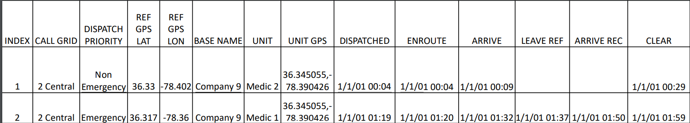
The Data
Originates from written charts made by EMS provider.
Dates changed to protect patients’ privacy.
Each row is a single trip
Analyze
Travel times
Associated system load
Different scenarios

Slide 4
Scenarios Overview
The data has 5 reasonable scenarios to perform our analysis on. The county have 4 total ambulances with 4 station locations- Near North, Far North, Central, and South.
Scenarios | S0 (Current) | S1 | S2 | S3 | S4
Far North | 0 | 0 | 1 | 0 | 1
Near North | 0 | 1 | 0 | 1 | 0
Central | 3 | 3 | 3 | 2 | 2
South | 1 | 0 | 0 | 1 | 1

Slide 5
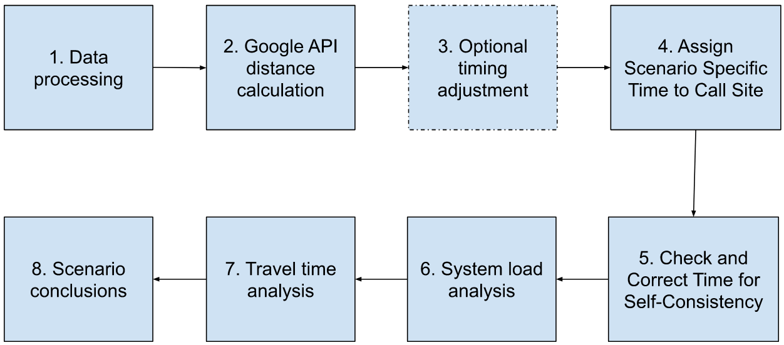
Proposed Analysis Pipeline
Notes:
Data Processing
Google API to generate new features on travel time
Best case, green light, average case, worst case
Timing adjustment (ambulance instead of car)
Assigning Specific Scenario Times to each Call
Checking and Correcting Time for Self-Consistency (check that api times are not bogus)
Perform system load analysis with binary indicator
Perform travel time analysis on dependency of travel times on scenarios
Reporting Conclusions/Findings

Slide 6
Data Preparation and Exploratory Analysis
Data Quality Check:
Decide whether to include data with atypical features
Example: calls outside Vance County Boundaries
Determine how frequently expected dispatch rules are followed
Example: all calls are addressed by an ambulance from nearest station, if there is an ambulance available
Recommended Initial Analysis of Temporal and Spatial Patterns:
Average distance and travel time from a call to each station
Call volume for each region (North, Central, and South)
For each region, call volume and average travel time by:
Hour of the day
Day of the week
Month of the year

Slide 7
Google Distance Matrix API Background
Takes multiple origin and destination locations
Returns a matrix of expected travel times and distances
Travel time estimations can be adjusted with parameters
Traffic Model: Optimistic, Pessimistic and Best Guess
Outputs are adjusted based on a ‘duration in traffic’ estimate
Expected durations for trips can only be projected on future dates. This could cause potential distortions to trip estimates and introduce noise or error
To reference the documentation for the Google Distance Matrix API click here

Slide 8
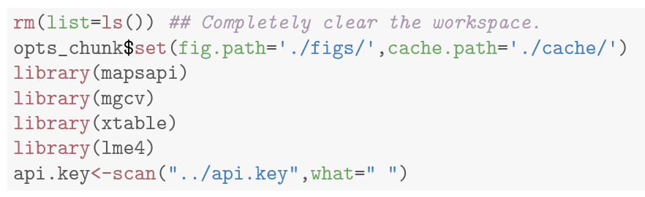
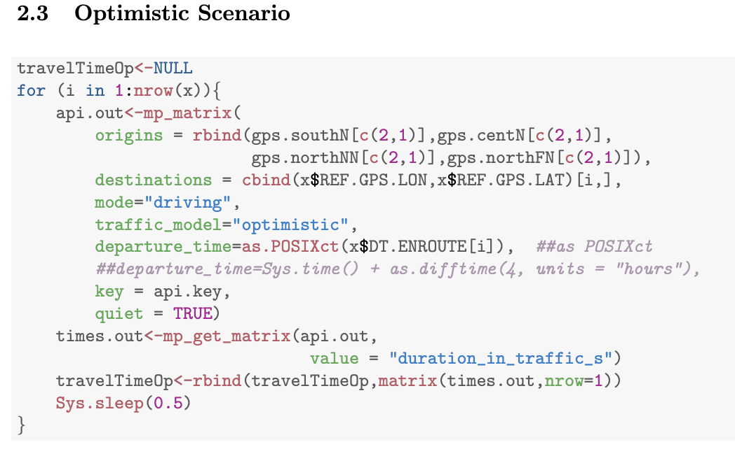

R mapsapi Package and Bandwidth Limitation
The R mapsapi package provides an interface to interact with the Google Distance Matrix API
Loaded into R via:
Limited bandwidth available when making calls / requests to API
Full analysis requires numerous individual requests separated by brief time delays
Example: “Sys.sleep(0.5)”
Introduces brief pause at end of each iteration to provide API sufficient processing time
Run code overnight
For-loop

Slide 9
Analyzing API Estimate Accuracy as an Optional Step:
Objective: Evaluate Google API estimates station-site travel times
Predictor Variables: Times (various API-estimated times), time of day (i.e. AM/PM, “8pm cutoff”), distance traveled, season, day of week, dispatch priority (emergency/non-emergency)
Analysis Framework:
Select predictor variables of interest.
Split data into testing & training sets; build each model using the predictors and best guess estimate.
Compare predictions using Root-Mean-Squared-Error (RMSE) calculations.
Determine if adjustments to API estimates are necessary based on model fit.

Slide 10
Simple / Multiple Linear Regression Model:
Bayesian Additive Regression Trees (BART) Model:
The simple linear regression model only has 1 predictor, compared to the multiple linear regression that has more than 1. Linear models are effective when the relationship between the predictor and response variables are approximately linear, meaning that the change in the response variable is assumed to be a constant times the change in the independent variable(s).
The BART model, a tree-based method, utilizes Bayesian decision tree frameworks to help capture nuanced, non-linear patterns in data, which can be helpful with travel time deviations and other factors that could affect your API estimates. The model can be represented by the sum of many individual regression trees that can approximate both linear and nonlinear functions.

Slide 11
Combining API Regression Model with Scenario Specifics
For each call, calculate the estimated travel times from all four stations (i.e. Google API’s Best-Guess model)
Example Scenario (Current: 3 ambulances in Central, 1 in South):
Observed call comes in from South district.
Calculate theoretical travel times from all four stations.
Assign the response time as the estimated travel time from South station.
(exception: if ambulance at South station is unavailable)
Update the response time as the estimated travel time from the second-nearest station, which is Central station for the current scenario.
Notes:
Travel times from all stations for all calls
Explain one scenario to clarify:
(baseline)
3central, 1 south
Call comes in from south
Then ambulance at south dispatches
(exception)
If south ambulance is on dispatch, then central ambulance goes out, so we’ll use calculated travel time there

Slide 12
Accounting for Overlapping Trips
PURPOSE: It is important to add a corrective step to account for overlapping trips. You need to identify the times when the dispatch occurs and when the closest vehicle is unavailable to respond.
STEPS:
Calculate the length of each trip by adding dispatch time and estimated travel time.
Account for differences between:
Ambulances being assigned a case and leaving the station
Arriving at the hospital and being available again
If the output of steps 1 and 2 are negative, then it indicates that there is no ambulance available to respond; therefore, the response time is affected.
Notes:
This is not response time, this is dispatch till hospital drop-off
If you just look at response time, you won’t be able to correctly account for overlapping trips aka when vehicles are not available
You have to account for the full time, from dispatch to “clear” → if currentRow[dispatch time] - previousRow[clear time] is negative, that’s when we can know the previous ambulance is not available.

Slide 13
Load Analysis
Purpose: Examine how the different scenarios would affect stress on Vance County’s EMS System
Method: Use a binary indicator to represent whether the ambulance at the closest station is available.
If the indicator is 0, the closest ambulance was not available
If the indicator is 1, the closest ambulance was available

Slide 14
Model 1
Purpose: To estimate the probability of whether a call’s closest station varies between the different scenarios
Steps:
Create a 0-1 binary indicator (dummy) variable for the event that load is not sensitive to scenario
Create a logistic regression model to identify time- or location-related variables that are associated with the dummy variable

Slide 15
Model 2
Purpose: Using only the calls that are predicted to vary across scenarios, this model will estimate the dependence of the load metric on scenario (i.e. how the load metric varies between different scenarios) by measuring the number of calls where the ambulance at the closest station was available for each scenario
Steps:
Create a logistic link Generalized Linear Mixed Model that includes a random effect for call ID and a fixed effect for scenario
Compare the different scenarios’ numbers to determine which scenario has the greatest number of closest station ambulance dispatches, and which has the least. To test for dependence on scenario, use a standard hypothesis test, and then to compare between different scenarios, use a likelihood ratio test.

Slide 16
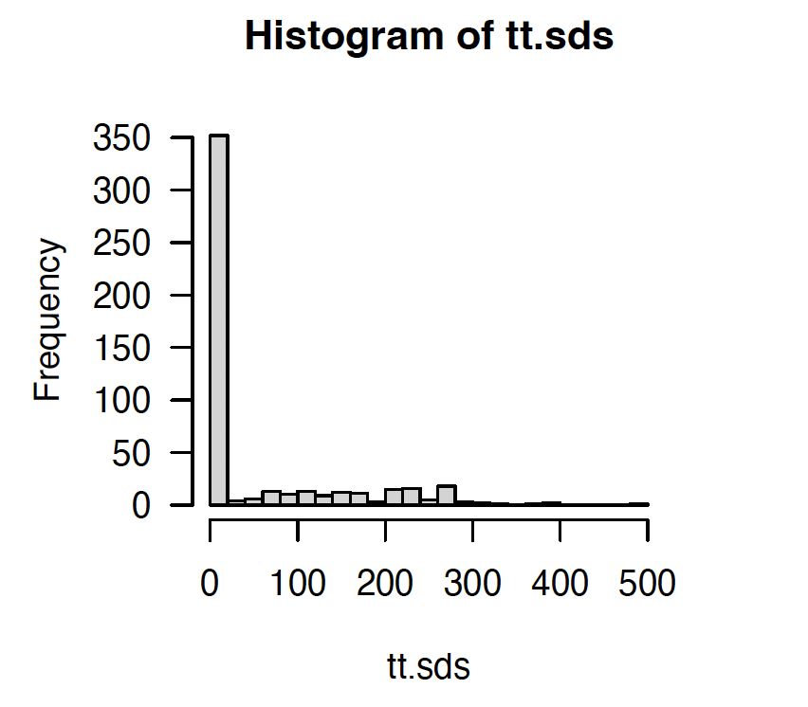
Understanding Travel Time Variations
Purpose: Discover whether the estimated travel times exhibit variation across different scenarios.
Method: Formulate a binary outcome, differ, where
1: there is a variation in travel time across scenarios
0: no variation
Then model differ using logistic regression.
Note: In many cases, since the ambulance dispatched under all scenarios comes from the same station, there are a number of exact 0’s.
Travel Time Standard Deviation (0 indicates no travel time difference across scenarios)

Slide 17
Logistic Regression for Modeling Difference b/w Scenarios
Model: The response variable is the binary outcome differ defined in the previous slide, and the predictor variables can be chosen from covariates such as season, hour of the day, day of the week, priority, and system load.
R Function: glm()
Interpretation: This model calculates the probability of observing a variation in travel times across scenarios, contingent upon the covariates.
In other words, it computes a sensitivity to scenario based on location and time coordinates.
For instance, during peak summer seasons or specific hours of the day, the model may predict a heightened probability of variation in travel times across various scenarios, potentially attributable to factors such as escalated traffic or road closures.

Slide 18
Modeling Travel Time with LMM
Purpose: When recognizing instances where travel times show discernible variations across different scenarios (i.e. when “differ” is predicted to be 1 in the logistic model mentioned in the last slide), you further model out how these times are dependent on the respective scenarios.
R function: lme4::lmer()
The Linear Mixed Model (LMM), especially employing the lme4::lmer() function in R, stands out as a robust tool for this purpose. If data exhibits clustering or repeated measures on each event, and you need to account for variability at different levels, then a Linear Mixed Model will work better than Linear Regressions.

Slide 19
Modeling Travel Time with LMM (cont.)
Model: include the response variable travel time (tt), a fixed effect (scenario), a random effect ((1 | eventID)), and additional covariates, such as time of day, season, system load
Interpretation: since the primary focus is on the impact of ambulance distribution on travel time, you should identify the baseline scenario and examine the offset term for each scenario in the model output

